Slide 1

Biodiversity in national parks
Shai Henare

Slide 2
Understanding the Data
Two datasets were provided by the National Parks Service:
Observations
Provides data on the number of observations of species found in four national parks
These four national parks are: Great Smoky Mountains, Yosemite, Bryce & Yellowstone
Species Info
Contains a couple key attributes of each specific species found in Observations:
Category: the species’ class (e.g. mammal, bird, vascular plant etc.)
Conservation Status: the classification of a species’ conservation status. There are four possible values for this attribute:
Species of Concern
Threatened
Endangered
In Recovery

Slide 3
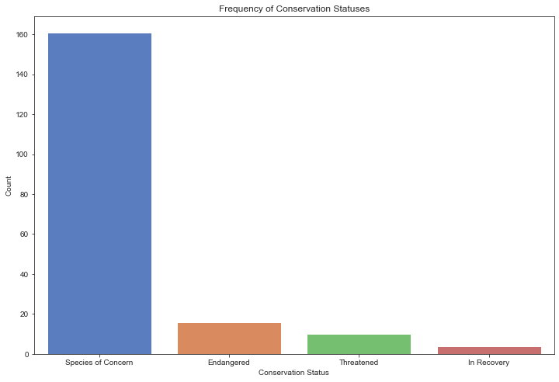
Frequency of Conservation Status
Of the 5824 different species in the dataset, 191 (3.3%) have a value in the conservation status column
160 (83.8%) of these are labelled as “species of concern”

Slide 4
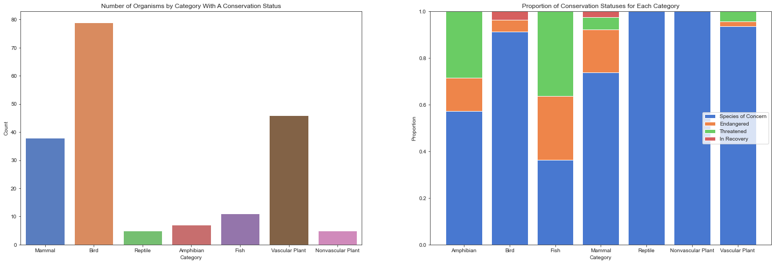
Frequency of Classified Species by Category
Of the 191 species with a conservation status:
79 are classified as birds
Next up in terms of frequency, are mammals and vascular plants
The other categories have 10 or fewer species with a classification

Slide 5
Conservation Status Proportion By Category
The larger the proportion of orange (endangered) and green (threatened), the greater the risk of extinction within species of a category
Via inspection of the visualisation, we can see that fish and amphibians are the category most at risk of extinction
Mammals also have a size-able proportion of endangered species

Slide 6
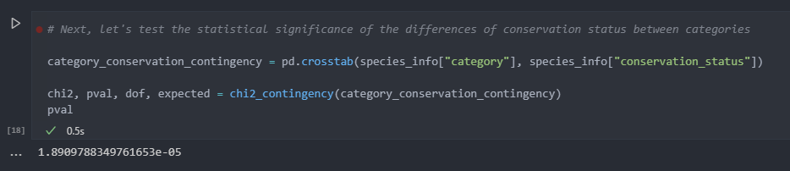
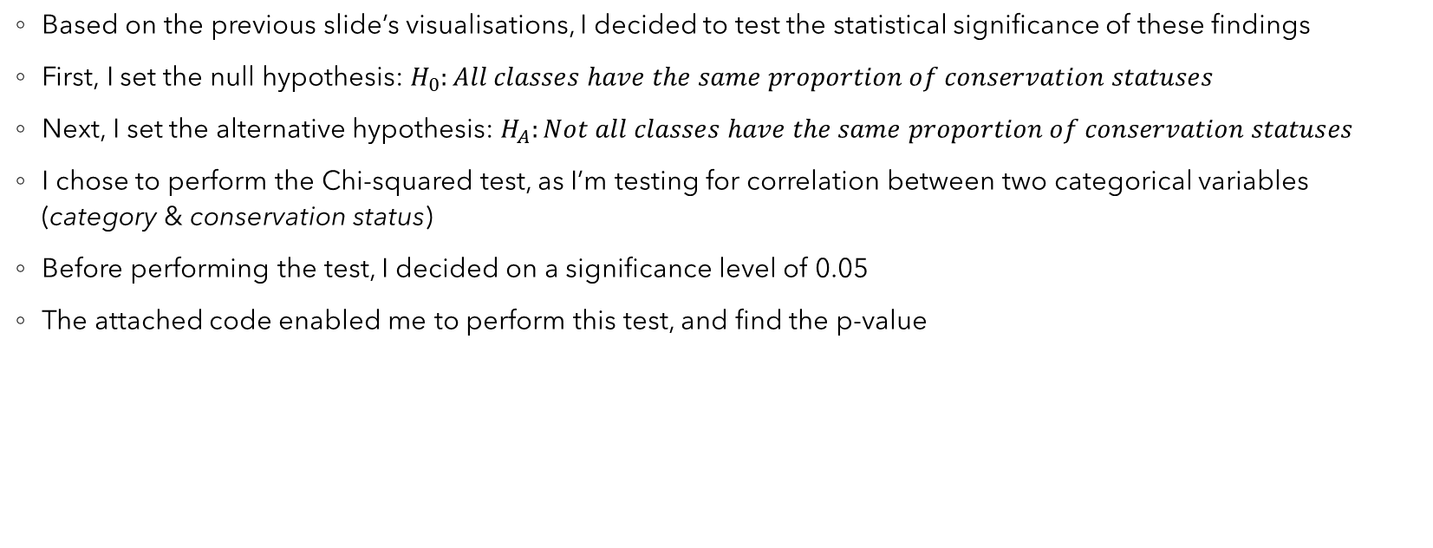
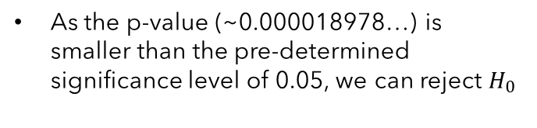
Testing the Statistical Significance
Based on the previous slide’s visualisations, I decided to test the statistical significance of these findings
First, I set the null hypothesis: $H_{0}:All classes have the same proportion of conservation statuses$
Next, I set the alternative hypothesis: $H_{A}:Not all classes have the same proportion of conservation statuses$
I chose to perform the Chi-squared test, as I’m testing for correlation between two categorical variables (category & conservation status)
Before performing the test, I decided on a significance level of 0.05
The attached code enabled me to perform this test, and find the p-value
As the p-value (~0.000018978…) is smaller than the pre-determined significance level of 0.05, we can reject $H_{0}$

Slide 7
Recommendations
After creating and inspecting visualisations, as well as testing the statistical significance of our findings, we can see that fish and amphibians most likely have a greater risk of extinction within these national parks
This suggests potential problems regarding water pollution in these parks
I would urge that the National Parks Service aims to significantly reduce sewage and chemical run-off into these waterways, as it’s clearly having a negative effect on the aquatic species of these parks
I would advise urgent action, as these suffering species play a key role in maintaining biodiversity within these ecosystems

